Slide 1
Research Methods in Business and Economics
Magdalena Zajączkowska, PhD
magdalena.zajaczkowska@uek.krakow.pl

Slide 2
Introduction to Module #1
Goals of the Module 1
Technical issues & student obligations
Introduction: knowledge and quality information

Slide 3
Goals of the Module 1: Literature search
Explain WHY student must learn how to locate and evaluate scholarly books, articles and working papers
Explain HOW to evaluate the content of scholarly rescources
TRAIN academic skills: referencing, literature search and reading, examining state of the art in scientific field/area

Slide 4
Structure:
Class #1: academic knowledge vs. popular one
Class #2: types of scholar rescources&referencing
Class #3: articles
Class #4: Internet search
Class #5: research problems&hypotheses
E-learning platform Moodle

Slide 5
WHY?

Slide 6
Not only because You have to…
You have to, because you need to search the scholarly literature to prepare your research project and – consequently – to graduate
You should to, as the ability of reading and creative thinking separates the CLEVER people from the rest

Slide 7
Nicholas G. Carr: Is Google Making Us Stupid? (2008)
„For me, as for others, the Net is becoming a universal medium, the conduit for most of the information that flows through my eyes and ears and into my mind”
„But that boon comes at a price. […]Media are not just passive channels of information. They supply the stuff of thought, but they also shape the process of thought. And what the Net seems to be doing is chipping away my capacity for concentration and contemplation. My mind now expects to take in information the way the Net distributes it: in a swiftly moving stream of particles. Once I was a scuba diver in the sea of words. Now I zip along the surface like a guy on a Jet Ski”

Slide 8
„Thanks to the ubiquity of text on the Internet, not to mention the popularity of text-messaging on cell phones, we may well be reading more today than we did in the 1970s or 1980s, when television was our medium of choice. But it’s a different kind of reading, and behind it lies a different kind of thinking—perhaps even a new sense of the self.”
„ Our ability to interpret text, to make the rich mental connections that form when we read deeply and without distraction, remains largely disengaged”

Slide 9
„I worry that the level of interrupt, the sort of overwhelming rapidity of information — and especially of stressful information — is in fact affecting cognition. It is in fact affecting deeper thinking. I still believe that sitting down and reading a book is the best way to really learn something. And I worry that we’re losing that” [Eric Schmidt, Google’s CEO]

Slide 10
In simple worlds
We’re flooded with information and we’re not able to process it
Browsing the Internet affects our cognitive patterns: we just look for BASIC information and we’re able to find it really fast
But we have problems in deep understanding of the subject
Knowledge of the 21-century ordinary people becomes very superfricial
No Google match = such think does not exist

Slide 11
Introduction: knowledge and quality information

Slide 12
What is the role of university?

Slide 13
University is a peculiar form of manufacturing entity
We PRODUCE the knowlege

Slide 14
You might ask: who cares?
Nowadays, the access to knowledge is democratic. Anyone can get free information and share this information with other people.

Slide 15
Well, the QUALITY matters

Slide 16
Where do you get knowledge?

Slide 17
Belief&Tradition
Authority

Slide 18
Belief&Tradition
During the socialization process, we learn a lot of things from our peers, parents, grandparents, other kins&friends…
We usually accept the great majority of those common „truths”… These are the things that “everybody knows.”

Slide 19
There are pros and cons of this knowledge

Slide 20
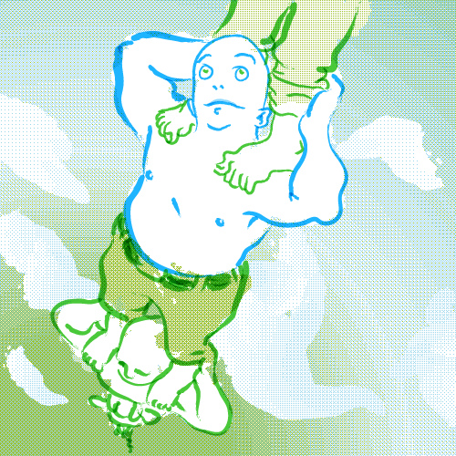
Positive aspects
We are standing on the shoulders of others: we do not have to learn everything from the very beginning

Slide 21
Negative ones
This knowledge is based on a social agreement
We believe that the reality looks in the following way (picture) because we were told so…

Slide 22
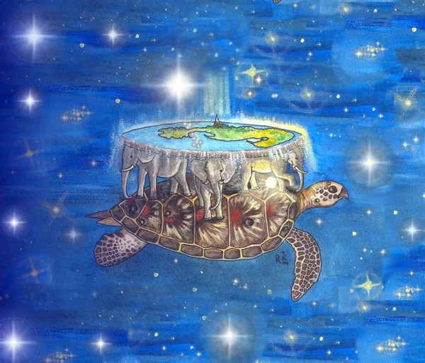

Slide 23
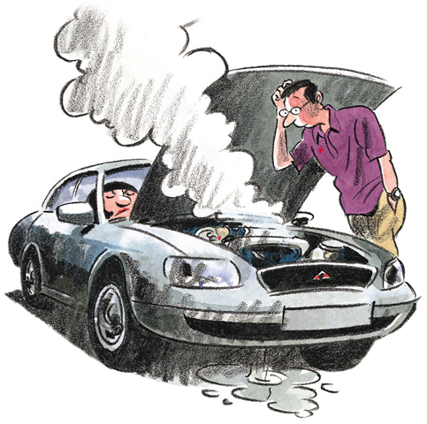
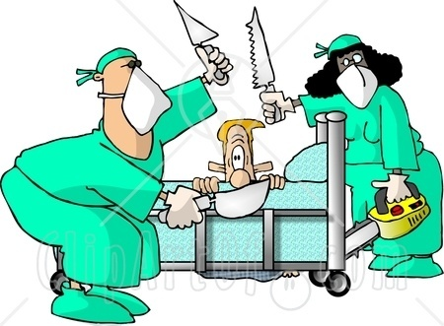
Authority
We trust the judgements of various experts

Slide 24
Common sources of information (and knowledge as well)
Web pages
Web search engines
Blogs
Forums
Social networks (Facebook, Twitter, TikTok etc.)

Slide 25
What are the weaknesses of those sources?

Slide 26
Common errors in our Inquires
Inaccurate Observations
Overgeneralization
Selective Observation
Illogical Reasoning

Slide 27
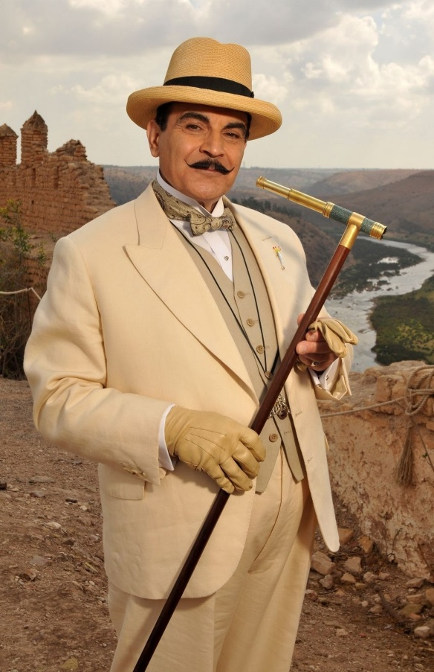
Inaccurate Observations
most of our daily observations are casual and semiconscious
this is often a nightmare for criminal detectives, who interwiew the witnesses…

Slide 28
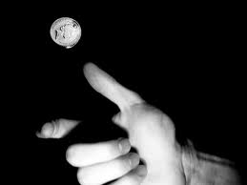
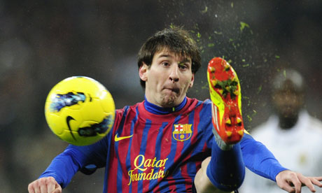
Overgeneralization
Assumption, that a few similar events provide evidence of a general pattern
we overgeneralize on the basis of limited observations

Slide 29
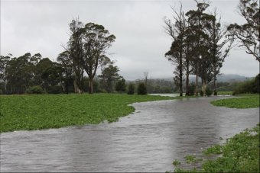
Selective Observation
we tend to focus on future events and situations that fit the pattern, and we tend to ignore those that do not
that’s how the folk sayings work…

Slide 30
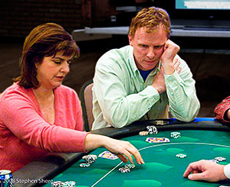
Illogical Reasoning
Typical example: „the exception that proves the rule”
gambler’s fallacy: we assume that a consistent run of either good or bad luck foreshadows its opposite (reverse of luck)

Slide 31
Academic knowledge should be
Reliable: the quality management system in science should be efficient
Neutral: no ideological bias should be tolerated
Clear and accessible: our products should be offered in the most comprehensive and user-friendly form

Slide 32
How it works?

Slide 33
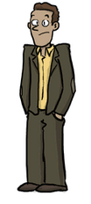
Project proposal
IDEA
IDEA Ver. 2.0
Discussion

Slide 34
Journal 2
Maybe?
$
Discussion
Paper
Results
No!!!
(desk rejection)
Journal 1

Slide 35
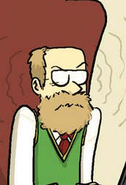
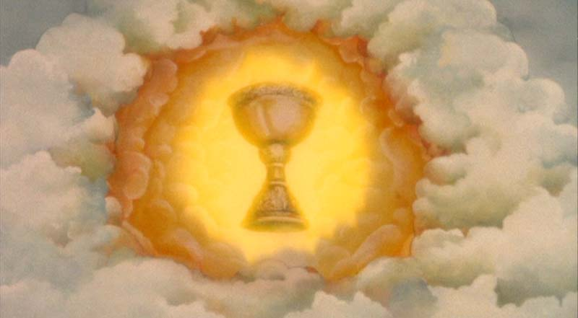
Negative
Reviewing process
Publication
Revision needed

