Slide 1
Research Methods in Business and Economics 4

Slide 2
Internet search
First, try to type some keywords of interest to general google
For instance: internationalization of enterprise

Slide 3
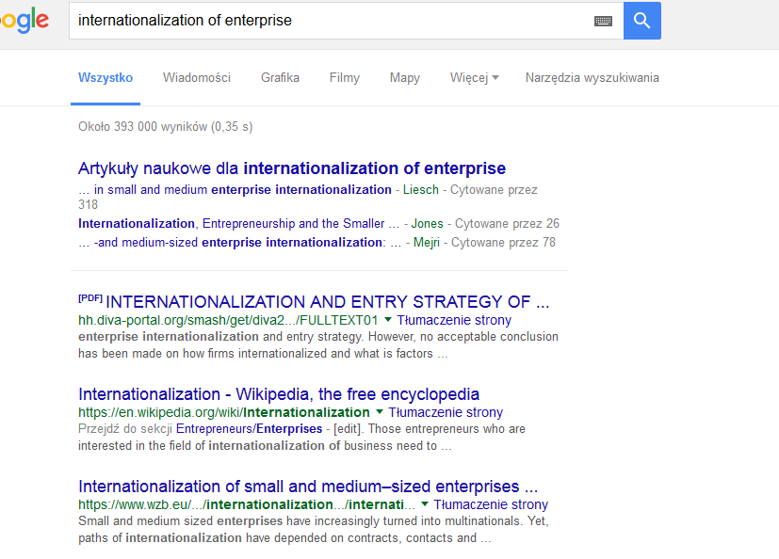
393 thousand matches, including some academic papers, but also research project web pages and commercial venues

Slide 4
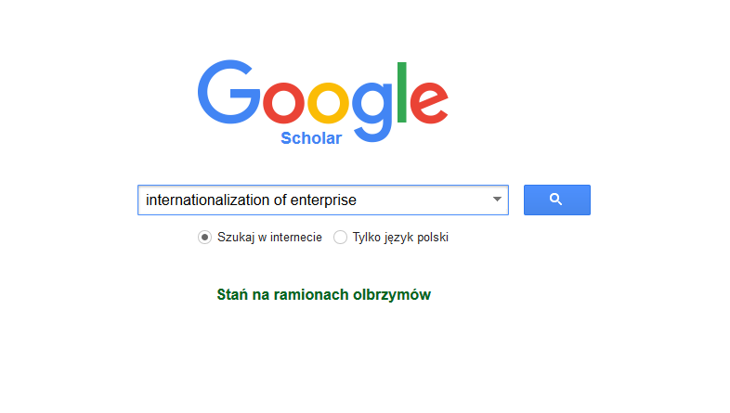
1st and more basic tool for students: google scholar

Slide 5
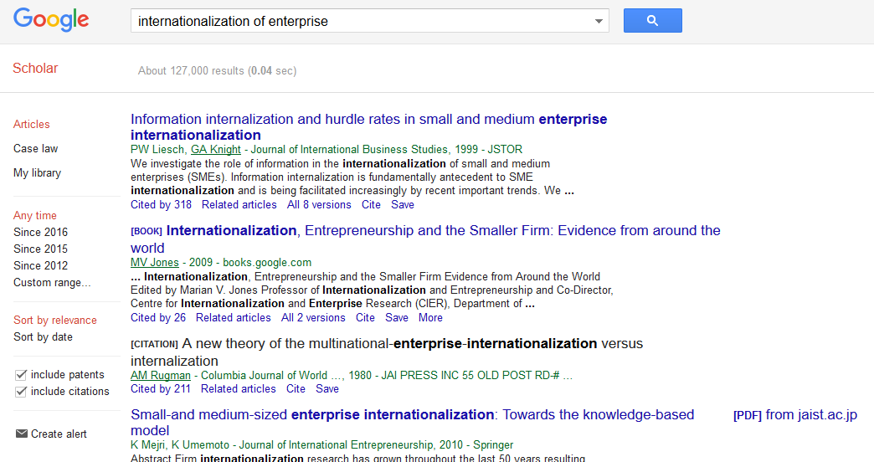
Now much better: 127 thousand matches

Slide 6
Google scholar
Articles ranked by keyword relevance, but also by numer of citations (proxy for popularity)
If assessed on the campus, you should have an immediate access to paper if we have the subscription via library

Slide 7
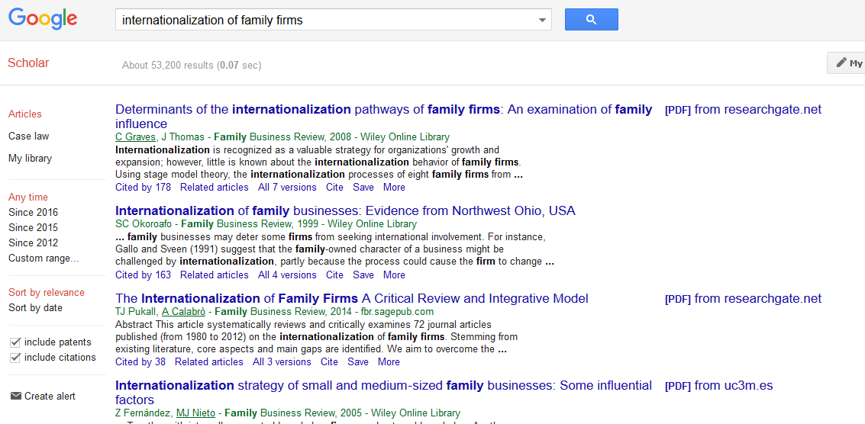
Now, let’s pick a more specific topic

Slide 8
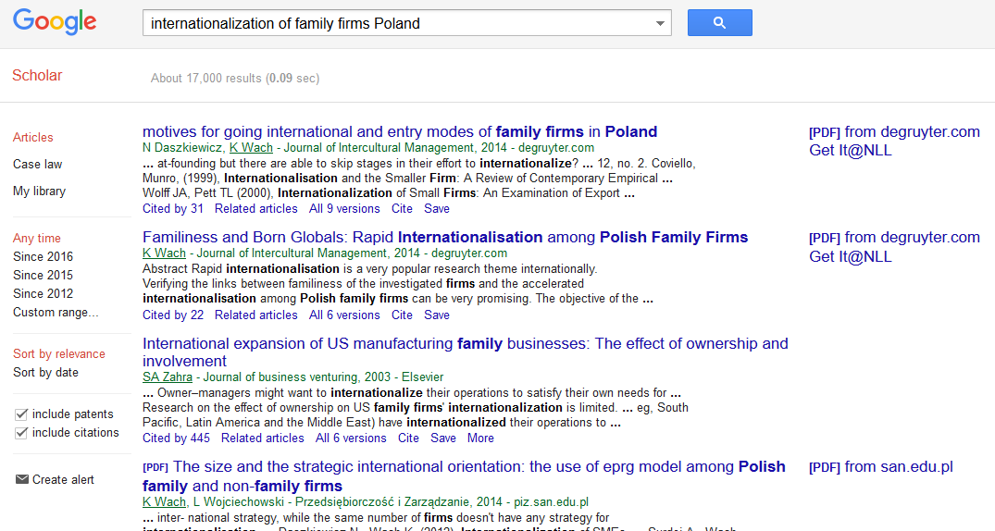
Then you can narrow your search by adding geographical location and by setting the timeframe

Slide 9
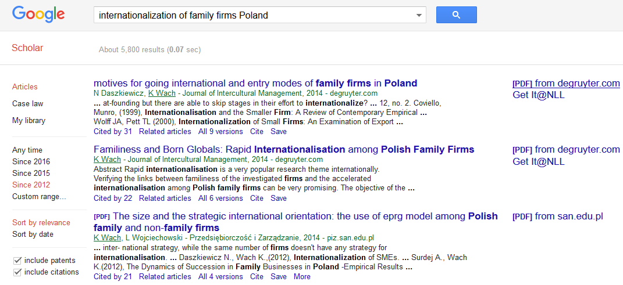
This topic is still very recent, so no big changes here. But you can check if the topic is a) not too narrow b) still popular (i.e. it is not a „dying topic”)

Slide 10
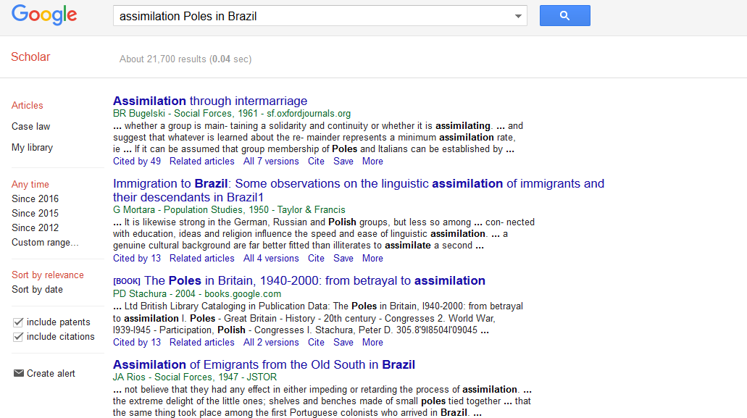
An example of dying topic

Slide 11
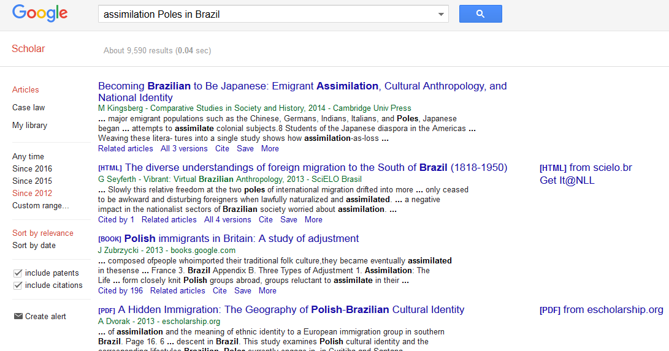
Most cited articles are quite old, very few relevant papers, and the relevant ones cover very old times (f.i 1818-1950)

Slide 12
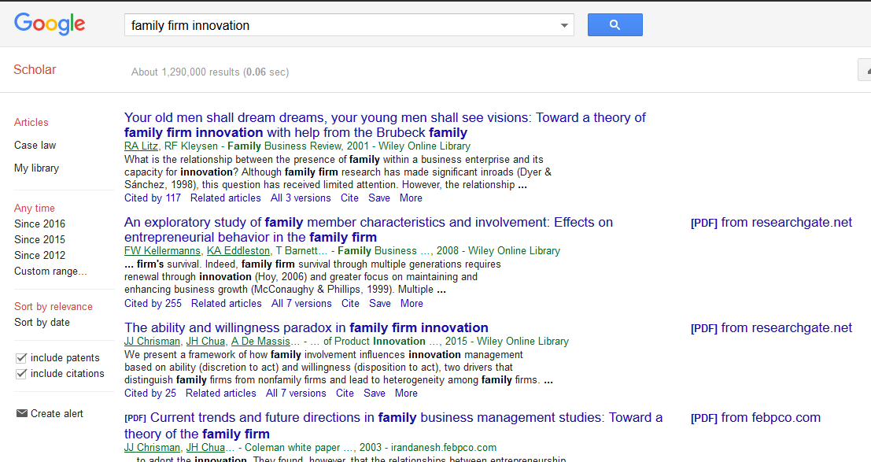
Ok., let’s assume that we’re interested in this paper

Slide 13
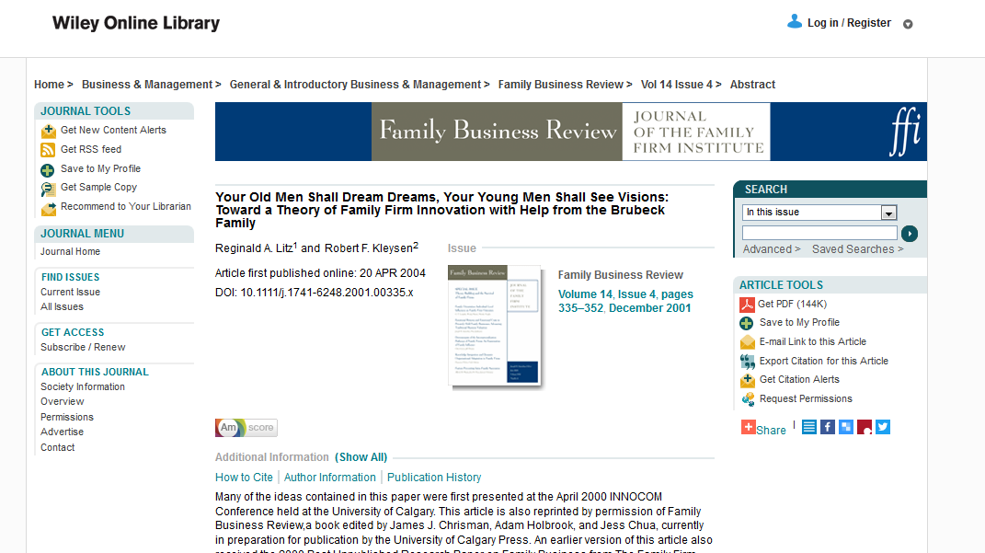
If you try to do it outside the campus, you will not be able to download the paper directly. When you click on it, you will be redirected to the web page of the publisher.

Slide 14
But there you can read the abstract. As you can see, the paper contains some literature review on family firms, which we find interesting.
Clicking on „Get PDF” button outside campus will not work… Probably they will ask you
for money☺

Slide 15
So, how to download this paper?

Slide 16
Option 1 – check google
First, check google scholar – very often you just need to click on the right, like in this case
Second, check general google by typing the title into search window

Slide 17
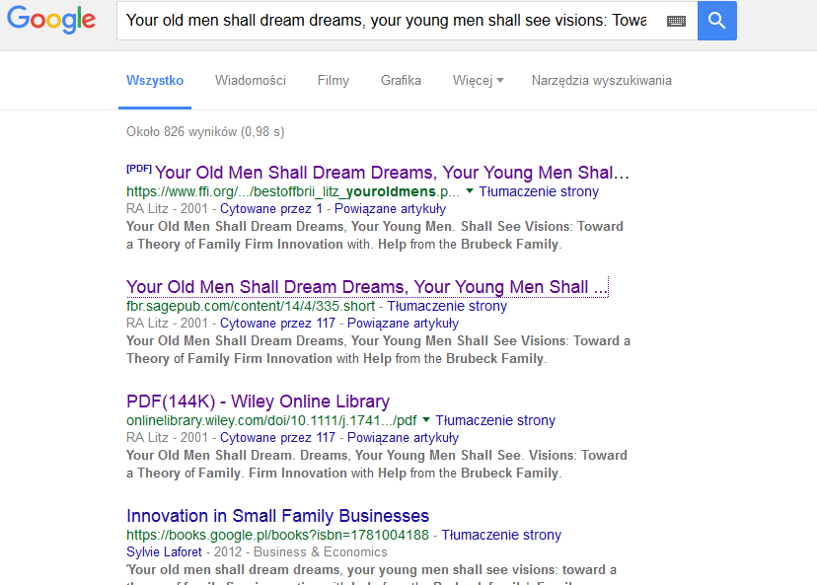

Slide 18
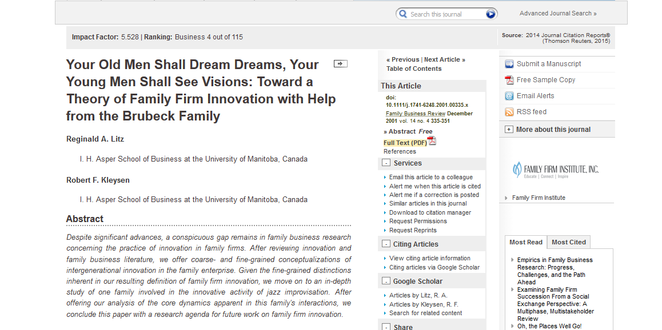
Here, you can enter a different web page of the publisher…

Slide 19
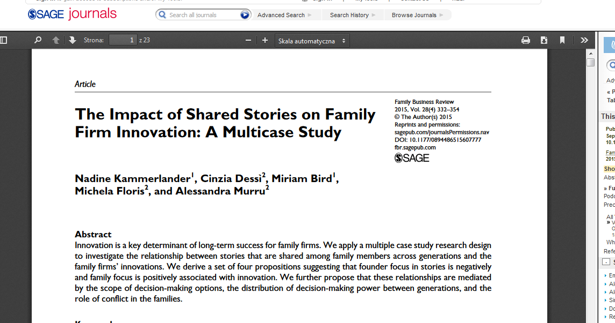
Surprisingly, here the download option works☺

Slide 20
Additionally, on general google you can sometimes find a draft version of the paper and/or working paper – which can serve as a proxy for paper

Slide 21
Option 2 – our library

Slide 22
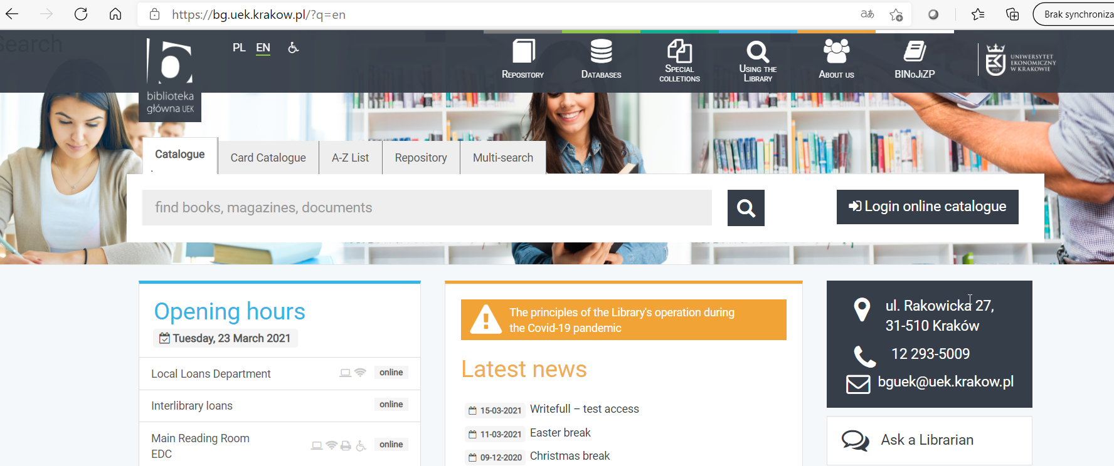
Go to databases (when being outside campus – you must register first)

Slide 23
Try various databases, the most popular are EBSCO and willey online library

Slide 24
Option 3
Check the following:
Social science research network
Researchgate
Academia.edu

Slide 25
Option 4
Ask your friend from a different university to check his/her library database

Slide 26
Option 5
E-mail the author (corresponding author, indicated on the web page of the journal)
Or
Ask for help on community profile (f.i. FB)
(both of theese might take some time)

Slide 27
How google scholar can be more helpful?
„Cited” button – shows all papers which have been citing this article!

Slide 28
So if you liked the paper, the other papers that cite it might be also important
Moreover, if it’s a review of literature – you can quickly update the review by adding more recent, relevant papers.

