Slide 1
Presentations by Józef Korzycki https://www.slidescarnival.com/roderigo-free-presentation-template/2154

Slide 2
Contents:
What is a presentation?
What is the purpose of my presentation?
Who are my audience?
Presentation structure
What tools can I use?
Visuals
Language of presentations
What else do I need to consider?

Slide 3
What is a presentation?
A prepared structured speech addressed to an audience to demonstrate or explain a new product or an idea in an attempt to inform or persuade the audience to do something, e.g. buy a product.

Slide 4
The why
There are really two reasons behind presentations:
to inform about an idea, a product (sales presentation) etc.
to convince people to do certain things (buy a product, award a contract, hire you for a job etc.)
In planning your presentation consider who your audience are, what they need to know and how you can communicate that to them.

Slide 5
Audience and their needs
1. Who are your audience?
2. What do you want them to know or do?
You need to:
tailor information to your audience’s needs – select, eliminate, adjust
convey it in an interesting and persuasive manner
explain words or concepts you yourself needed to research

Slide 6
Preparation
Good presentation is impossible without prior preparation.
Preparation means you need to:
decide on your subject
organise your presentation
rehearse it before delivery

Slide 7
Subject
Choose a subject that will be of:
interest and
Benefit to your audience
By choosing this very subject what do you want to achieve?
inform?
persuade?

Slide 8
Organisation – beginning
Organise your presentation.
It needs to have:
1. beginning, where you
Welcome,
Introduce yourself and the subject
Outline how the audience will benefit
Advise about handouts
Advise about questions
List the main parts of you presentation

Slide 9
Beginning –cont’d
Start out with a bang to capture attention:
Startling fact
Statistic
Question
Quotation

Slide 10
Main body
2. Main body, giving the main information in a structured manner.
Name and then develop the main points of your presentation.
Follow this arrangement:
Say what you are going to speak about
Speak about it
Advise that you are moving to the next point
Point 1 (introduce –develop)
Point 2 (introduce –develop)
Point 3

Slide 11
Main body – cont’d
Repeat important information,
Use visuals
Involve audience:
- ask a question
- pass a sample

Slide 12
Ending the presentation
3. End
To close the entire presentation:
Summarise the main points
Invite and answer questions
Thank the audience
Remind them how they will benefit from your presentation
Bid the audience farewell

Slide 13
Rehearsal- acting out, performing your presentation.
Tips:
1. Start out by rehearasing chunks of presentation – beginning, end, transition points until memorisation is adequate
2. Rehearse in front of mirror or record and analyse your performance
3. Solicit feedback form others – team members, friends, colleauges
4. Rehearse enitre presentation against the clock, recreating actual setting
PRACTICE MAKES YOU PERFECT!
https://www.youtube.com/watch?v=TSiXtrVaYA0

Slide 14
Technical and performance related issues
Presentation tools
Setting up and winding down
Body language
Enthusiasm
Slides
Langauge of presentations
Presentation assessment

Slide 15
What presentation tools do I use? (font size 40)
What application?
Word?
Powerpoint?
Prezi?

Slide 16
WORD (font size 24 bold)
Good morning everyone
Thank you very much for giving up
I hope that by the end of the day
Well, some of you may know me better than
Now do know that one of the magic rules for presentations says that you should limit your presentation to just 3 main points and you’ll never fail?
Did you know that?
Anyways, the topic of my today’s presentation is – guess what? – PRESENTATIONS
My purpose is to introduce you to the world of effective presentations.
My major goal is to see you enabled in a not too-distant future to deliver a solid presentation – and in English, for that matter!
How does that sound to you?
Is that acceptable?
Let me outline the structure of today’s presentation.

Slide 17
PowerPoint
https://www.slidescarnival.com/roderigo-free-presentation-template/2154#preview

Slide 18
Prezi
https://prezi.com/?placement=&gclid=CjwKCAiA_c7UBRAjEiwApCZi8bcpGEmoEOsv3P28Dm_U494sDYhOvY36M4iNSJf2k41PCQRbm22AARoCEdgQAvD_BwE&KW=%2Bpresentation&creativeID=251672794519&c3api=7659&matchtype=b

Slide 19
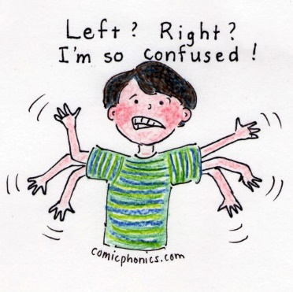
Body language - what, where and how (font size 24)
Should you have a sitting or standing posture?
Standing
Maintain comfortable, upright posture,
Avoid:
Hand in pocket
Clasped hands
Flailing hands
Fig leaf position
Hanging on to the lectern
Busy hands (playing with notes or pen)
T-Rex arms (arms close to sides, bent at 90 degrees, with hands dangling in front of body)
http://www.virtualspeechcoach.com/2013/10/02/speak-with-confidence-stand-and-move-with-power-and-purpose/

Slide 20
Hands
Use your hands to strenthen your message:
accentuate important word/s
indicate an important point
invite audience to look at a visual aid

Slide 21
Posture – cont’d
Presenting is a physical activity – so move around reasonably!
Initially move from left to right
Then your movement should reflect what you say
Close distance between audience and yourself when you want to sell them an idea
Stand still when you are saying something important

Slide 22
Eye contact
Making eye contact with your audience establishes a connection and portrays sincerity and confidence – only liars avert eyes or look away
TEQUNIQUES - IMORTANT
try not to stare at a single listener
do not look at the wall at the other end, the ceiling or the window
If you are using notes, hold them up high enough so that you can glance at them without having to drop your head much
They should not be held so high that they block your face

Slide 23
Slides and you
When displaying slides, make sure you:
face audience
Stand off centre, to one side
Turn sideways to the main screen (but never with your back to to the audience) to refer to an item on display
Have your laptop between you and audience, facing laptop screen

Slide 24
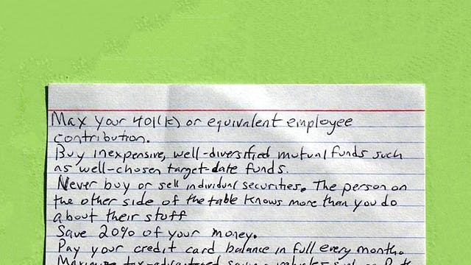
Notes and Memorisation
Memorise as much as possible –
Always: introduction, conclusion, relevant presentation phrases
Keep notes to a minimum
If necessary, use index cards
https://www.google.pl/search?q=index+card&safe=active&client=firefox-b&dcr=0&source=lnms&tbm=isch&sa=X&ved=0ahUKEwiNyuDbu-fZAhVHYZoKHcThAfAQ_AUICigB&biw=1280&bih=887#imgrc=nYRKmCUX_Q4OBM

Slide 25
Venue – the where
https://www.google.pl/search?q=position+of+power+in+presentation&safe=active&source=lnms&tbm=isch&sa=X&ved=0ahUKEwjrmKvOwsPZAhUpiKYKHQOWCoEQ_AUICigB&biw=1280&bih=887#imgrc=ECUxp8kRpMZNVM:

Slide 26
The what and the how
https://www.youtube.com/watch?v=3Lazy26m1Io
Remember:
What you say is important,
how you communicate it can make a difference.

Slide 27
Enthusiasm
I would rather listen to an enthusiastic speaker than a lucklustre one!
Enthusism means:
Passion
Energy
Being knowledgeable and at one with the topic
Enthusism often makes the difference between success and failure

Slide 28
Voice quality – the do’s
Modulate your voice
Make pauses after important points, use moments of silence
Speak loudly enough for people in the back to hear you clearly
Articulate so that your words are clear and easily understood
Speak at a pace allowing your audience to take in what you are saying

Slide 29
Voice quality –don’ts
Traps can be avoided when you remember the following:
Not too loud
Not too fast
Not boring
Avoid „fillers” - errs, uhms, sighs, giggle etc.
Avoid awkward pauses or moments of silence

Slide 30
Other tips
Smile!
Try to minimise your stage fear!
Remember that your audience are people – like yourself
Take a few deep breaths
Sip some water to calm you down
Focus on topic and not audience

Slide 31
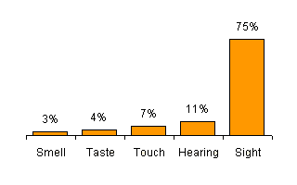
Do we need visual aids?
Consider this bar chart!
https://www.webconference.com/webconferencing/zeropanel.php?base=orange&left=70light30dark.php&content1=benefits/statisticsyoumustknow.php&title0=Statistics%20You%20Must%20Know&titlepic=2

Slide 32
Visual aids
Why visuals?
Visuals
Engage sense of sight – retention soars from 11% to 75%,
Make presentations lively and help capture attention
Assist speaker
Add class and infuse a sense of professionalism

Slide 33
Visuals – cont’d
Rember size matters!
Size implies importance - the bigger the size, the more impotant the item is made
Make visuals easy to read even from the last row and make them easy to understand

Slide 34
Letter size and fonts
Calibri size 36
Arial size 32
Times New Roman size 28
Constatntia size 24
Old English text size 20
Tahoma size 18
Yu Gothic size 16
Freestyle script size 14
Calibri size 12
Calibri bold size 12

Slide 35
Script – useful tips
Centre titles and headlines
Use:
bullet points and
other markers
Favour the upper two thirds of the slide
Do not use ornamental letter fonts
Do not alternate between fonts and letter sizes
Check and correct spelling

Slide 36
Slides – don’ts
Don’t:
Insert more than 7 lines per slide
if letter size suffers
your slide is a disaster waiting to happen
Put more than 7 words into the line
(The 7 x 7 rule in Powerpoint)
Q: In my presentation, do I do what I preach?

Slide 37
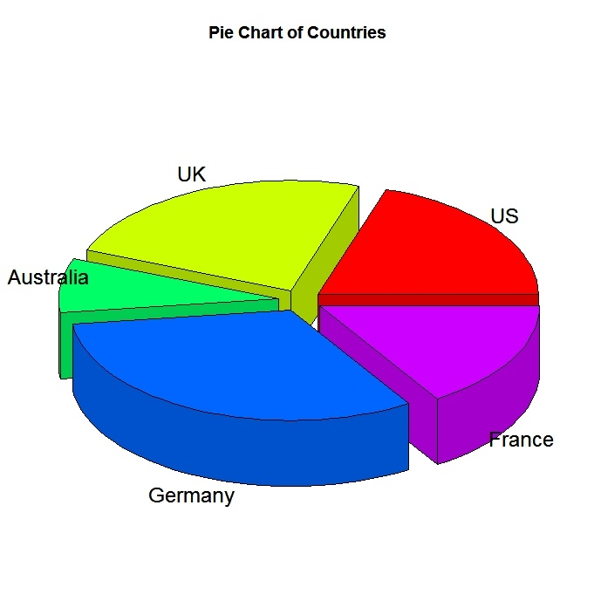
Graphs and charts – pie chart
Light green slice
Red segment
Blue sector
Purple quadrant
https://www.google.pl/search?q=pie+charts&safe=active&source=lnms&tbm=isch&sa=X&ved=0ahUKEwiqsNjvqMTZAhUpiaYKHcpSB7MQ_AUICigB&biw=1280&bih=887#imgrc=7xbFscrAhHZlEM:

Slide 38
Bar chart
Yellow, green, blue bars
https://www.google.pl/search?q=bar+charts&safe=active&source=lnms&tbm=isch&sa=X&ved=0ahUKEwj8we7Bq8TZAhWFlSwKHeBnB7kQ_AUICigB&biw=1280&bih=887#imgrc=UL-ei4rBuBP95M:

Slide 39
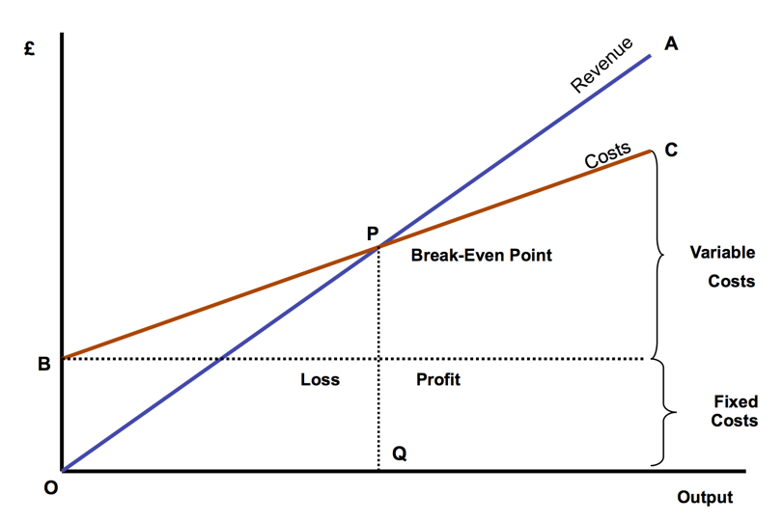
Graph
Blue line and brown line,
curve
https://www.google.pl/search?safe=active&biw=1280&bih=887&tbm=isch&sa=1&ei=o2SUWvD8HMSasAHg7baICw&q=break+even+graph&oq=break+even+grap&gs_l=psy-ab.1.0.0i19k1l7j0i30i19k1j0i5i30i19k1l2.18193.22745.0.25074.17.14.1.2.2.0.171.1809.0j12.12.0....0...1c.1.64.psy-ab..2.15.1847...0j0i67k1j0i30k1.0.lK8QdVniVGk#imgrc=dkrSADWN0MZAAM:

Slide 40
Describing diagrams
The pie chart/bar chart/line graph/table below/above shows/illustrates/presents …
When you look at the diagram, you will see that …
The red slice/bar/line shows ….
It can be seen that the numer of …. fell/increased slighly/significantly from 10 in 2011 to 20 in 2012.
The numer of …. is relatively small/high.
However, while the numer of X decreased, the number of Y increased over the last … years/on the previous year.
Overall, we can see a clear upward/downward trend.

Slide 41
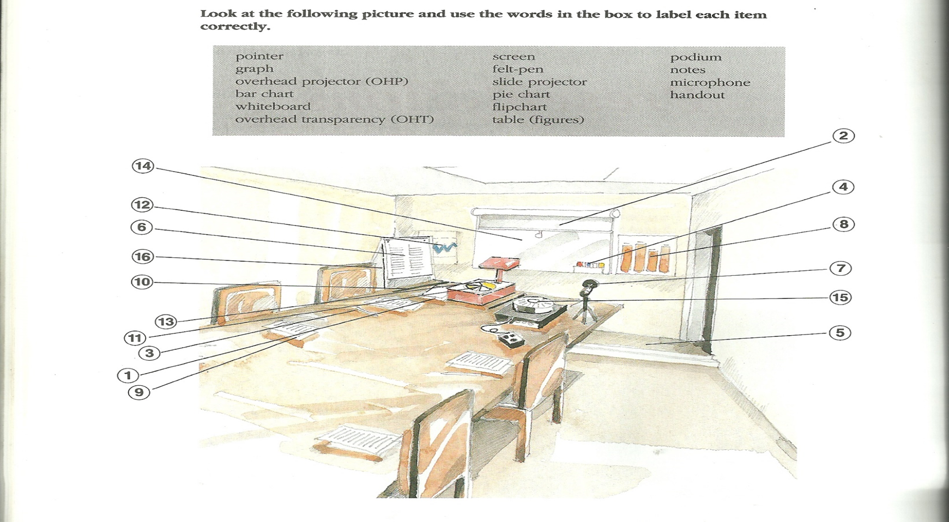
Presentations- equipment
D. Cotton, S. Robbins, Business Class (Eninburgh: Thomas Nelson and Sons Ltd, 1993), 36.

Slide 42
Language of Presentations - Starting it all &Greetings
OK, shall we start?
Let’s begin, shall we?
It’s time to to Begin my/our presentations
Good morning, ladies and genetlement/everybody
Thank you all very much for coming here today
I hope you all had a pleasant journey here today

Slide 43
Introducing yourself & co-speaker/s
Self-introduction
My name is …
Some of you may know me better than others. My name is … and I work for …/My field of expertise is …
My name is … and I will co-host today’s presentation with …
Introducing guest/co-speaker
It gives me a great please to introduce Mr/Ms …, who will speak about

Slide 44
Introducing topic
Introducing the topic
My topic today is… My talk is concerned with ...
I’m going to divide this talk into four parts There are a number of points I'd like to make Basically/ Briefly, I have three things to say

Slide 45
Outlining structure and sequencing
I'd like to begin/start by ... Let's begin/start by ... First of all, I'll...
Secondly, …
Thirdly, … … and then I’ll go on to … Then/ Next ... Finally/ Lastly ...

Slide 46
Useful verbs
I would like to:
analyse
consider
discuss
expand on
explain
focus on
introduce
look at
talk about

Slide 47
Finishing a section/moving on to next section
That's all I have to say about... We've looked at... So much for...
Moving on
I’d like to move on to my next topic: …
Moving on now to … Let’s turn now to … The next issue/topic/area I’d like to focus on … I’d like to expand/elaborate on … Let's look now at...

Slide 48
Analysing a point and emphasising
What does this mean for...? Translated into real terms... Why is this important? The significance of this is...

Slide 49
Giving examples
A good example of this is... Le me give you an example:...
To illustrate this point...
To better understand the point, you might want to consider this example:

Slide 50
Summarising and concluding
In short ...
Let's summarise briefly what we've looked at... To conclude... In conclusion ... If I can just sum up the main points... So, to remind you of what I’ve covered in this talk, …

Slide 51
Focusing on visuals
Now, if you just look at this slide, you will see that …
I’d like to draw you attention to this next slide.
As you can see …
This slide shows/illustates …
Let’s look at the figures: …
Can you just look at the handouts. As you will see ….

Slide 52
Paraphrasing and clarifying
What I mean is this: …
In other words ….
To put it more simply …

Slide 53
Inviting questions
Now is the time to answer your questions.
I’d be glad to take your questions now.
Do you have any questions?
If you’d like me to elabortate on any/this question, now is the time time to ask

Slide 54
Answering question
Thank you. That is certainly a very interesting question
Well, let me try to answer that
Now, that’s interesting that you should asnl this question
I’m afraid I don’t have the information now, but I can get back to you by email. Can I have your address afterwards

Slide 55
Ending the presentation
That’s all from me. Thank you very much for being such an attentive audience
I hope you feel that your time has been well spent
It was a pleasure talking to you. Have a safe journey home and a nice day

Slide 56
Final points to remember
1. Prepare your presentation
2. Tailor it to the needs of your audience
3. Rehearse it thoroughly
4. Proofread it carefully/spellcheck it, learn to pronounce difficult words
5. Anglicise the pronounciation of foreign words

Slide 57
Final points – cont’d
6. Set yourself up – your laptop, pen drive, cables, notes, etc.
7. If you feel nervous - remember that everybody does.
Take a few deep breaths and focus on your theme, not the audience
6. If you make an error, forget your script or don’t know –
don’t pretend nothing has happened – just admit it,
apologise and
move on.

Slide 58
Final points – cont’d
7. When you use external information – name the source to avoid charge of plagiarism
8. Whenever you get a hostile audience – handle them diplomatically – show them your class
9. When you speak do it with enthusiasm and conviction
10. Have handouts to give away after your presentation

Slide 59
Presentation research
Bear this in mind:
Research shows that after a presentation:
55% remembered your behaviour
38% the tone of your voice
7% what the actual message was

Slide 60
That’s all folks
Thank you!

