Slide 1
Articles
Checking the journal reliability
Types of articles
Basic structure
Reading assignement

Slide 2
Checking the journal reliability
Articles are (usually) the most reliable source of academic knowledge
Why?

Slide 3
Reviewing process
In order to get published in a journal, the submitted paper undergoes the reviewing process
Usually is a double-blinded review: two anonymous refrees assess the quality of argumentation, research methods and results
The reviewer can suggest that a paper should be accepted, give reccomendations for minor and major changes and reject the paper

Slide 4
Impact Factor (IF)
The best (so far) indicator of academic excellence of a given journal
Proxy measure for importance of journal in a given field
Shows the average number of citations per paper in a given period

Slide 5
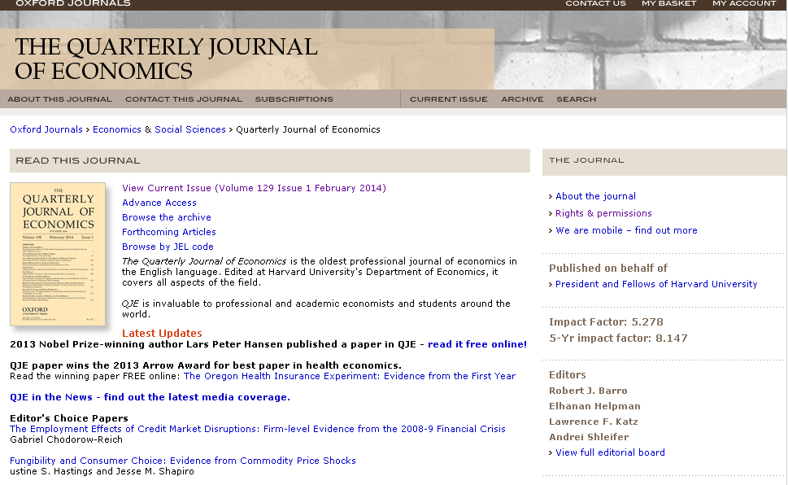
Here it means that an average paper from this journal was cited 5 times (which is a lot).

Slide 6
Types of articles
Reviewing paper
Theoretical paper
Research paper
Explorative paper

Slide 7
Reviewing paper
The most suitable to get started
Describes the state of the art in the given field
Shows basic findings and theoretical concepts
Offers suggestions for further research development
A quick knowledge pill for a student who starts the research project

Slide 8
Theoretical paper
Develops an existing theory or creates a new one
In business&economics: usually shown in form of a complicated theoretical model (lots of math equations and formulas)
Still, it might be useful for you (esp. the introduction and final conclusions)

Slide 9
Research paper
Shows the results of original empirical research
Sometimes describes also data collection
The description of research methods might be difficult for you, but the basic results overwiew can be interesting
Moreover, sometimes you might be able to make use of data presented in your research project

Slide 10
Explorative paper
Usually a starting point for future research, written often by PhD students
Written in order to get the basic insight into the research problem
Might be useful and inspirational for your research problem formulation process

Slide 11
Basic structure

Slide 12
Title page
Publisher
Name of journal
Volume, year of publication, pages
Title: this one is quite informative
Authors and
Corresponding
author

Slide 13
Abstract&keywords
Write them down for further search on google scholar and other repositories

Slide 14
Introduction
Relates to the existing research and theory (a short review of the state of the art)
Describes the aims of the study
Shows the structure of the paper

Slide 15
Conclusion/final remarks
Depicts the results of the study
Verification of the hypotheses (if any)
Discusses the further research perspectives
Reflects on possible implications (political, economic etc.)

